Slide 1


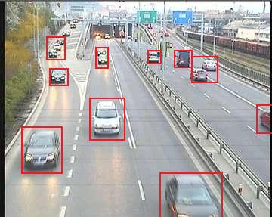
OPENCV – PYTHON
OPENCV CAR detection AND LANE Detection and pedistrain detection and voice assisting
This Photo by Unknown Author is licensed under CC BY-SA
This Photo by Unknown Author is licensed under CC BY-SA

Slide 2
Member of our team
Param shankar (lane drawing ,bounding rectangle and counting cars)
Shaurya Mishra (voice assisting, speed function , masking out the image for lane drawing )
Tej patel (make the ppt , he took out the co ordinate with the help of matplotlib, imported the videos ,showing the image and adding dealy to it )
Level of our team members
1. param intermediate(2-3)
2. Shaurya intermediate(1-2)
3.Tej beginner (6moths – 1 year )

Slide 3
Let us import the files
I imported the
cv2 module
Matplotlib.pylab module as mp
Os module
Numpy module as np
Datetime module as dt
Import pyttsx3 engine = pyttsx3.init()

Slide 4
Time spam of our code
#timeline of our code #10:15 till 11:15 we write the line from 1 to 51 #from 1 to 51 two people of our team has written the code param and shaurya #other all the lines of code take around the 1 hours to 30 min from (1:00 pm to 2:00pm and from 3:00pm to 3:30pm ) # it took us 2. 30 hours in total to write the code but it took 1 debug the code() #it took around 45 min to debugging our code which is from which is from (4:45 to 5:37) #it was not showing the lane when we run the project and it took us to 40 min to sort that error (as 5:40 we were having the stem ai workshop so we started to work on lane at 7:10 and to 7:40 # it took 40 min sort the lane error ) #in total we can say that we took 4 hours to complet code including debugging #WE ADED THE VOICE ASSTING AND COUNTUG THE NUMBER OF CAR IN FRAME IT TOOK US AROUND AN HOUR E STARETD AT (10:00 PM AND FINISHED AT 12:10 AM )
#and made the ppt in between (1:40 am to 2: 40 am )

Slide 5
IMPORTING VIDEO AND PRE TARINED ALGORITHM
#saying cv2 to to reconize my file of video video = cv2.VideoCapture('car5.mp4') #callsifyng pre trained algorithm car_detect_file = 'cars_op.xml' body_detect_file='haarcascade_fullbody.xml'
IMPOTING VIDEO
IMPORTING PRE TRAINED ALGORITHM

Slide 6
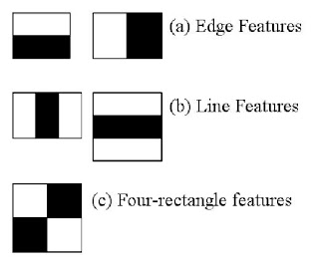
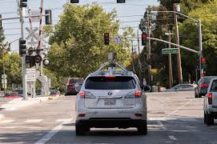
CALSSIYING PRETRINED ALGORITHM
#cascade clasfify car_classify = cv2.CascadeClassifier(car_detect_file) body_pedi_callify = cv2.CascadeClassifier(body_detect_file)
#sayign it to dectcte multisale car_detect = car_classify.detectMultiScale(frame) #the errror was here that we use the body_detect_file insted of using the body_pedi_calsify body_detect=body_pedi_callify.detectMultiScale(frame)
EXPLAING U CASCADE THOURGH CAR EXAMPLE

Slide 7
READING EACH FRAME IN VIDEO USING LOOP
while True: op_sucess, frame = video.read()
SAYING CV2 TO READ EACH FRAME

Slide 8
SHOWING IN THE IMAGE AND ADDING DEALY
#showimg the video in winodw uaing cv2 method called imshow cv2.imshow('tesla_backend', frame)
#matplotlib window # mp.imshow(frame) # mp.show() #adding dealy to image if cv2.waitKey(30) & 0xff == ord('q'): break
cv2.imshow('screen', blank_imgae)
SHOWING THE IMAGE
ADDING DEALY
AND USING MATPLOT LIB

Slide 9
PUTTING LIVE DATE AND TIME
#putting live date and time o frame #the one error was here brcuse here we have not converted it to str and we were using it as the int date_time = str(dt.datetime.now()) cv2.putText(frame, date_time, (10,10), cv2.FONT_ITALIC, 0.5, (225, 0, 0), 2)
USING MODULE PUTTING DAT EAND TIME
AND PUTTTUNG IT AS TEXT

Slide 10
BOUNDING RECTANGLE AROUND CAR
for x,y,w,h in car_detect: #COUNTING NO. OF CAR MADE BY PARAM no_of_car = no_of_car + 1 no_of_car_s = f'no.of car around you = {no_of_car}' text = f'{no_of_car},"VEHICLE"' # showing the no. of car and and puuting text on top left coner of recatngle cv2.putText(frame, text, (x, y), cv2.FONT_ITALIC, 0.6, (0, 255, 0), 2) # putting txt on recatangle cv2.putText(frame, no_of_car_s, (15, 30), cv2.FONT_ITALIC, 0.8, (225, 0, 0), 2) cv2.putText(blank_imgae, no_of_car_s, (15, 60), cv2.FONT_ITALIC, 0.8, (225, 0, 0), 2) #drawing recatngle around it cv2.rectangle(frame, (x, y), (x + w, y + h), (0, 225, 0), 3) #dectCing that if car is overtaking X_co =x+w Y_co =y+h if X_co >470 or 183 and Y_co>245 : cv2.putText(frame, "car overtaking ", (250, 300), cv2.FONT_ITALIC, 1, (0,0,0), 2)#we get the co ordiante form matplot.pylab cv2.putText(blank_imgae, "car is overtaking miantain your speed ", ((30), round(height/2)), cv2.FONT_ITALIC, 1, (0, 0, 225), 2) else: pass if no_of_car> 4: # puttign text if anyone does not here sound cv2.putText(blank_imgae, "Be Careful there are more car around you ", ((20), round(height / 3)), cv2.FONT_ITALIC, 1, (0, 0, 225), 2) else: pass
COORDINATE
BLOUNDING RECATNGLE AROUND IT USING CV2 FUNCTION
ALSO CALLSIFYING THE OVERTAKING OBJECT AND COUTTING NO. OF CAR

Slide 11
USING DRAWLINE FUNCTION AND BOUNDING RECTANGLE AROUND PEDISTARIN AND HUMAN
for x,y,w,h in body_detect: cv2.rectangle(frame, (x, y), (x + w, y + h), (225, 225, 224), 3) cv2.putText(frame, "OBSTALE", (x, y), cv2.FONT_ITALIC, 0.5, (0, 255, 0), 2) #PRITNNG CO-ORDINATE OF ACR AND BOVY OR PEDISTARAIN print(car_detect) print(body_detect) #the one error was here becuse at some point it does not detct line so it was shwing error try: frame = lane_draw(frame) except TypeError: cv2.putText(frame,"no lane dectedc", (100, 700), cv2.FONT_HERSHEY_DUPLEX,3,(0,225,0),thickness=2)
USING PRE DEFINIG FUNTION TO DRAW LINE
PUUTING TEXT AND BOUNDING RECTANGLE
SORTING IF ERROR OCCURE

Slide 12
Explanation of our first function
def region_of_inter(img,vertices): mask = np.zeros_like(img) match_mask_color = 255 cv2.fillPoly(mask,vertices,match_mask_color) masked_image = cv2.bitwise_and(img,mask) return masked_image
So in the first line I def my fution anemm and the parameter that I need for my function
In second line I used the np.zero_like method to create the blank image of my image that I have taken as parameter
In third line give the color of region of interestas 225 which is black
And I used the cv2 function called as fillpoly ans I filld my polygon or the part that I don’t need I my lane detection
And then I merged the two image using cv2.bitise_and and passed the two image my image from user and blank imge
And then I return the imge which is masked

Slide 13
Explantion of my second function
def draw_line_image(img, lines): #making the copy of imaeg #the reason it was not showing the lane was that we left parmeter of np.copy emplty so it was not showing the lanes img = np.copy(img) #we haave left the papmeter blank in img.shpae blank_imgae = np.zeros((img.shape[0], img.shape[1], 3), dtype=np.uint8) #inderting over each item for line in lines: for x1,y1,x2,y2 in line: #here it was drwaing the line which is nor vertical but it was drawn along the y axis as we in pt2 we passed x1 insted of x2 cv2.line(blank_imgae,(x1,y1), (x2,y2), (0,0,225),thickness=10) #the one error was herhe taht we give more weight to blacnkimge so we were not able to see the image img = cv2.addWeighted(img, 0.8, blank_imgae, 1, 0.0) return img
In define my function and parameter that I nned from user
In second line I make the copy of image using np.copy that user gave me in parameter
In third line is created the blank image of same dimensions using the img.shape[0],img.shape[1] here 0 =width and 1 = height of image and 3 = no. channel in the image and the data type is np.uint8
And in fourth line used the line that i get from user and iterate over each item I line using for loop and again iterate over the coordinate that I get in I line
And in next line is used the function called as cv2.line to draw line on the image using co-ordinate that I get from user’s and draw them on blank image that I made in upper lines
And using the cv2.addWeighted method to merge to merge images in which it include the imegs with line and image from user
And retrun the image that I merged or with lines

Slide 14
Third of my function called lane_draw
def lane_draw(imgae): #at some time after in the video that it was showing error that it was not getting the height try: height = imgae.shpae[0] width = imgae.shape[1] except AttributeError: pass region_of_intrest_ver =[ (0, 384), (183, 245), (470,245), (640, 340) ] try : blur_image =cv2.GaussianBlur(imgae, (5,5)) #canny imaaegs canny_img = cv2.Canny(blur_image,100,200) except: canny_img = cv2.Canny(imgae, 100, 200) #image with masked of polygone masked_image = region_of_inter(canny_img, np.array([(region_of_intrest_ver)], np.int32), ) #praoblistic hough line trandform p_line = cv2.HoughLinesP(masked_image, rho=6, theta=np.pi/180, threshold=140, minLineLength=30, maxLineGap=10) #images with lines img_with_lanes = draw_line_image(imgae, p_line) return img_with_lanes

Slide 15
ExplainTION OF MY LANEDRAW FUNCTION
I DEFINE MY FUNTION AND PEREMETERI WANT
TO SORT THAT IF ERROR WOULD OCCURE IN DEFINE HEIGHT AND WIDTH USING TRY EXCEPT
CO CORDINATE OF PART THAT I DID’T WANT
REDUING IMAGE NOISE AND DETECT IN EDGE WITH CANANY METHOOD
AND PUT THE TRY AND EXCPET FOFR FOR ERROR
MASKING THE IMAGE USING MY PRE DEFINE FUNTION
USING THE HOUGH LINE TRNSFORM TO GET PREDETECTED LINE TRANSFROM IN WHICH WE USE THE POLAR SYSTEM
AGAIN USING PRE DEFINE FUNTION TO DARW TWH LINE ON IMAGE
RETURN

Slide 16
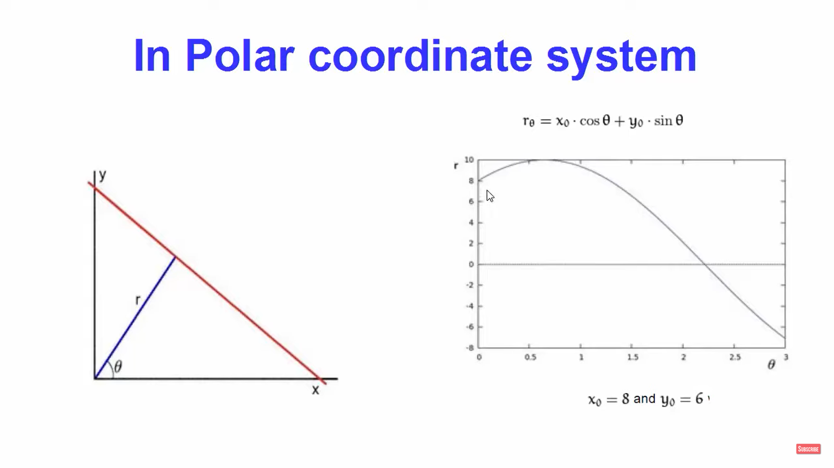
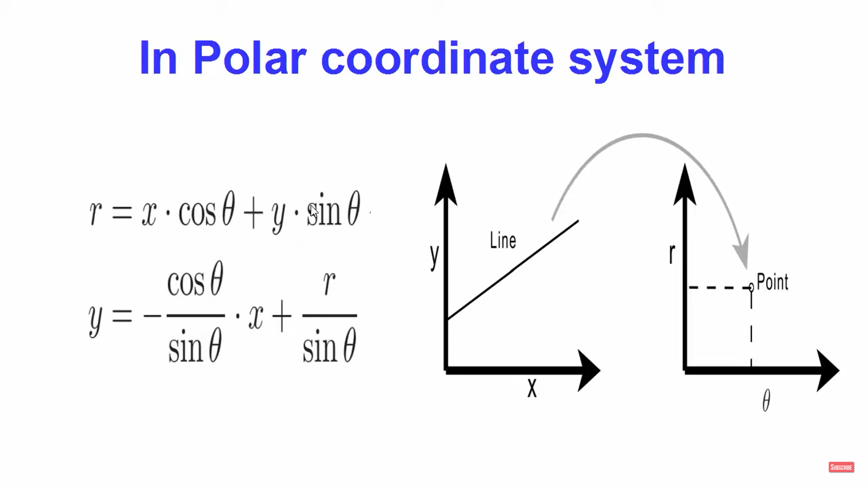
HOUGH LINE TRANSFROM
REASON WHY WE USE THE POLAR SYSYTEM BECAUSE CARTISEAN SYSTEM IS NOT ABLE TO DARW THE LIEN VERTCIALLY AND IN OENCV WE WILL USE THE PROBALISTIC HOUGH LINE TRNASFORM

Slide 17
Hough line argumnets
is the value of rho which is distance resloution accumualtion in pixel
third is theta which is angle resoultion of acuumalator in circle
fourth is threshold of line that lie are retuend which are higher than certain of threshold
maxlinelenght it is the certina amout of vale if lien lenght is samlmmler tahn this lenght than this will not show the line
minlinegap similary in maxlineleght

Slide 18
Expected speed calculated by us using function
def speed(image): for x,y,w,h in car_detect: #one error was herhe that we ahev given the white spcae between sum_Y sum_y = np.sum(y) speed = float(y/60) speed1 = round(speed) speed2 = str((speed1)) text =f'{speed2}pxpersec' cv2.putText(image,text,(x-w,y+w), cv2.FONT_ITALIC,0.5,(225,225,225),2) return image
We calculated speed using the funton called as speed
function made by Shaurya Mishra
Level of Shaurya itermideate

Slide 19
VOICE ASSISTANT IN CAR DETECTION FOR BLIND PEOPLE
if no_of_car > 5: #puttign text if anyone does not here sound engine.say("Be Careful there are more than five car aroudn u ") engine.runAndWait() else: pass
WE USED THE PACKAGE CALLED AS pyttxs3
TO USE THE VOICE ASSTSTING FOR MORE THAN 5 FIVE
THIS CODE IS WRITTEN BY SHAURYA OF VOICE ASSTSTING
THIS SPECIALLY WRITTEN FOR BLIND PEOPLE

Slide 21
THE END
HOPE U LIKE THE PROJECT AND EXPLAINATION

